Slide 1
Data Ingestion: Sqoop & Flume
Julien Heck
Hadoop and Managing Big Data
UCLA Extension

Slide 2
Sqoop
In the previous lesson we learn about different type of storage repositories outside of HDFS.
To interact with such external storage, MapReduce programs need to use external APIs.
Often, valuable data in an organization is stored in structured data stores such as relational database management systems (RDBMSs).
Apache Sqoop (which is a portmanteau for “sql-to-hadoop”) is an open source tool that allows users to extract data from a structured data store into Hadoop for further processing. This processing can be done with MapReduce programs or other higher-level tools such as Hive, Pig or Spark.
Sqoop can automatically create Hive tables from imported data from a RDBMS (Relational Database Management System) table.
Sqoop can also be used to send data from Hadoop to a relational database, useful for sending results processed in Hadoop to an operational transaction processing system.

Slide 3
Sqoop
Sqoop includes tools for the following operations:
Listing databases and tables on a database system
Importing a single table from a database system, including
Specifying which columns to import
Specifying which rows to import using a WHERE clause
Importing data from one or more tables using a SELECT statement
Incremental imports from a table on a database system (importing only what has changed since a known previous state)
Exporting of data from HDFS to a table on a remote database system

Slide 4
Sqoop Connectors
Sqoop has an extension framework that makes it possible to import data from — and export data to — any external storage system that has bulk data transfer capabilities.
A Sqoop connector is a modular component that uses this framework to enable Sqoop imports and exports.
Sqoop ships with connectors for working with a range of popular databases, including MySQL, PostgreSQL, Oracle, SQL Server, DB2, and Netezza.
As well as the built-in Sqoop connectors, various third-party connectors are available for data stores, ranging from enterprise data warehouses (such as Teradata) to NoSQL stores (such as Couchbase).
There is also a generic JDBC (Java Database Connectivity) connector for connecting to any database that supports Java’s JDBC protocol.

Slide 5
Text and Binary File Formats
Sqoop is capable of importing into a few different file formats.
By default, Sqoop will generate comma-delimited text files for our imported data.
Delimiters can be specified explicitly.
Sqoop also supports SequenceFiles, Avro datafiles, and Parquet files.
These binary formats provide the most precise representation possible of the imported data.

Slide 6
How Sqoop works
Sqoop is an abstraction for MapReduce, meaning it takes a command, such as a request to import a table from an RDBMS into HDFS, and implements this using a MapReduce processing routine. Specifically, Sqoop implements a Map-only MapReduce process.
Sqoop performs the following steps to complete an import operation:
1. Connect to the database system using JDBC or a customer connector.
2. Examine the table to be imported.
3. Create a Java class to represent the structure (schema) for the specified table. This class can then be reused for future import operations.
4. Execute a Map-only MapReduce job with a specified number of tasks (mappers) to connect to the database system and import data from the specified table in parallel.

Slide 7
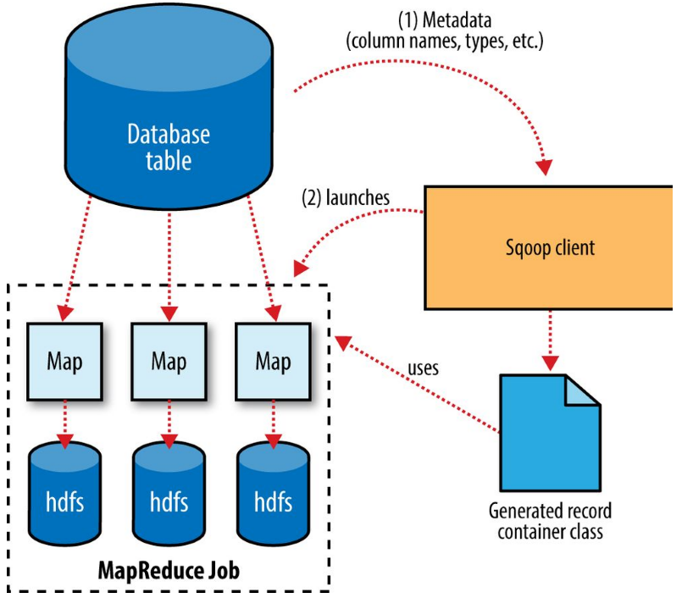
Sqoop Import

Slide 8
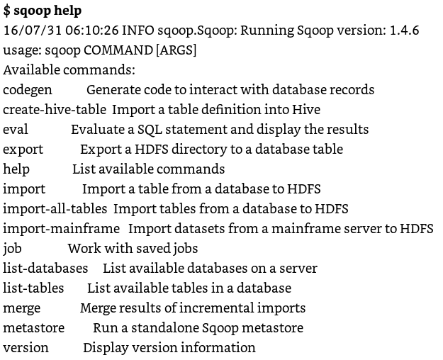
Sqoop Tools

Slide 9
Sqoop Import – Example
Login to Canvas and go to Module 4 – Exercise Sqoop 1

Slide 10
Imports and Consistency
When importing data to HDFS, it is important that you ensure access to a consistent snapshot of the source data.
We need to ensure that any processes that update existing rows of a table are disabled during the import.

Slide 11
Imported Data and Hive
Using a system such as Hive to handle relational operations can dramatically ease the development of the analytic pipeline.
Sqoop can generate a Hive table based on a table from an existing relational data source.

Slide 12
Import into Hive – Example
Import HDFS files into Hive using Sqoop.
Login to Canvas and go to Module 4 – Exercise Sqoop 2

Slide 13
Performing an Export
In Sqoop, an import refers to the movement of data from a database system into HDFS.
By contrast, an export uses HDFS as the source of data and a remote database as the destination.
We can, for example, export the results of an analysis to a database for consumption by other tools.
Before exporting a table from HDFS to a database, we must prepare the database to receive the data by creating the target table.
Although Sqoop can infer which Java types are appropriate to hold SQL data types, this translation does not work in both directions.
You must determine which types are most appropriate.
When reading the tables directly from files, we need to tell Sqoop which delimiters to use.
Sqoop assumes records are newline-delimited by default, but needs to be told about the field delimiters.

Slide 14
Export: A deeper look
The Sqoop performs exports is very similar in nature to how Sqoop performs imports.
Before performing the export, Sqoop picks a strategy based on the database connect string.
Sqoop then generates a Java class based on the target table definition.
This generated class has the ability to parse records from text files and insert values of the appropriate types into a table
A MapReduce job is then launched that reads the source datafiles from HDFS, parses the records using the generated class, and executes the chosen export strategy.
Separate threads are used to read from HDFS and communicate with the database, to ensure that I/O operations involving different systems are overlapped as much as possible.

Slide 15
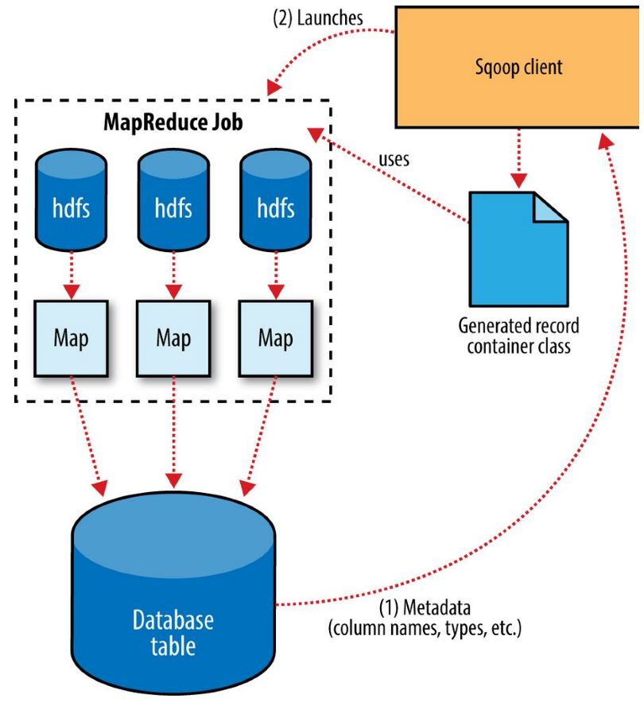
Export: A deeper look

Slide 16
Sqoop Exercise
Performing an Export: Export from HDFS to MySQL
Login to Canvas and go to Module 4 – Exercise Sqoop 3

Slide 17
Kafka
Apache Kafka is a popular distributed, reliable, low-latency, pub-sub (publish-subscribe) messaging platform developed at LinkedIn.
Kafka acts as a write ahead log (WAL) for messages, much the same way a transaction log or journal functions in an ACID data store.
This log-based design provides durability, consistency, and the capability for subscribers to replay messages if required.
Kafka publishers are called producers, and producers write data to topics. Subscribers in Kafka, called consumers, read messages from specified topics.

Slide 18
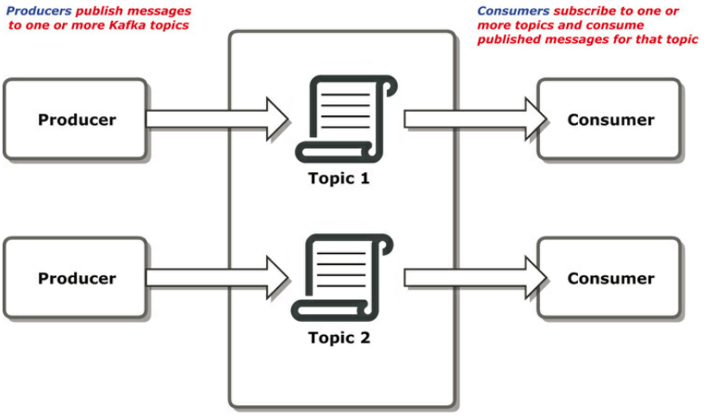
Kafka

Slide 19
Kafka
Kafka is a distributed system consisting of one or more brokers, typically on separate nodes of a cluster.
Brokers manage partitions, which are ordered, immutable sequences of messages for a particular topic.
Partitions are replicated across multiple nodes in a cluster to provide fault tolerance.
Topics may have many partitions.
Each topic in Kafka is treated as a log (an ordered collection of messages), with a unique offset assigned to each message. Consumers can access messages from a topic based upon these offsets, allowing a consumer to replay previous messages.

Slide 20
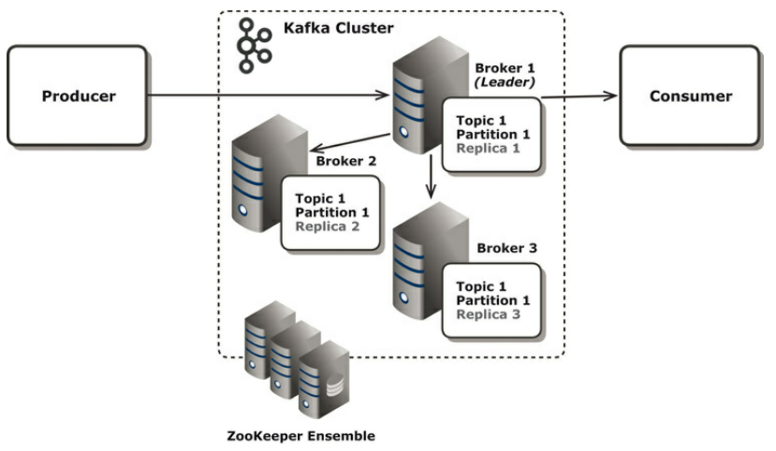
Kafka

Slide 21
Assignment
Login to Canvas and go to Module 4 – Assignment Sqoop

Slide 22
References
White, Tom. Hadoop: The Definitive Guide: Storage and Analysis at Internet Scale, O'Reilly Media.
Aven, Jeffrey. Hadoop in 24 Hours, Sams Teach Yourself, Pearson Education.
Sundog Education by Frank Kane, The Ultimate Hands-On Hadoop - Tame your Big Data!

